Slide 1
Application of Steerable Filter and Multi-attribute Display in Crack Detection of 3D Coherence Data
Speaker: Liao.L
Tutor: Zhenming Peng & Bingjie Tao
IDIPLAB · UESTC

Slide 2
Introduction
Method
Experiment*
Conclusion

Slide 3
1.1 Edge detection
Crack detection belongs to edge detection.
Edge detection includes a variety of mathematical methods that aim at identifying points in a digital image at which the image brightness changes sharply or, more formally, has discontinuities.
-- Wikipedia
mid-level
Pixel-level
Segmentation
Representation
&
Description
Object-level
high-level
Preprocessing
Knowledge
Based
(Image analysis system)
Recognition
&
Interpretation
Res.
low-level
Prob.
Acquisition

Slide 4
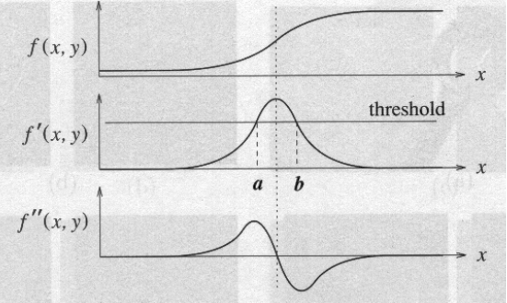
1.2 Classic Edge detection Algorithm
Points which lie on an edge can be detected by:
(1) detecting local maxima or minima of the first derivative
(2) detecting the zero-crossing of the second derivative
Filtering to approximate first derivative
Computation of gradient magnitude
Thresholding
Input image
(grayscale)
(1)
Output image
(binary)
(2)
Smoothing
Filtering to approximate second derivative
Zero-Crossing (with threshold)

Slide 5
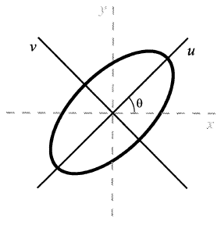

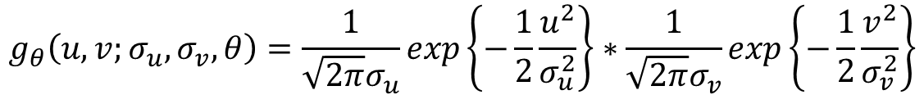
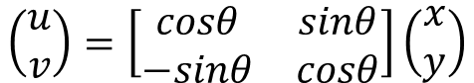
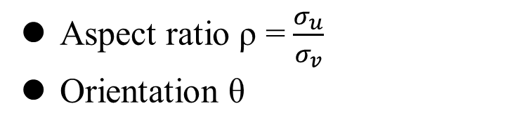
1.3 Direction Constrained Gaussian Filtering
$$g_{θ}\left(u,v;σ_{u},σ_{v},θ\right)=\frac{1}{\sqrt{2π}σ_{u}}exp\left\{−\frac{1}{2}\frac{u^{2}}{σ_{u}^{2}}\right\}∗\frac{1}{\sqrt{2π}σ_{v}}exp\left\{−\frac{1}{2}\frac{v^{2}}{σ_{v}^{2}}\right\}$$
$$\left(\begin{matrix}u \\ v\end{matrix}\right)=\left[\begin{matrix}cosθ & sinθ \\ −sinθ & cosθ\end{matrix}\right]\left(\begin{matrix}x \\ y\end{matrix}\right)$$
Aspect ratio ρ =$\frac{σ_{u}}{σ_{v}}$
Orientation θ
ρ and θ control the direction of Gaussian filtering
Every orientation needs a filter, which is complicated and time consuming;
It’s difficult to extend to high-dimensional data.

Slide 6
Introduction
Method
Experiment
Conclusion

Slide 7
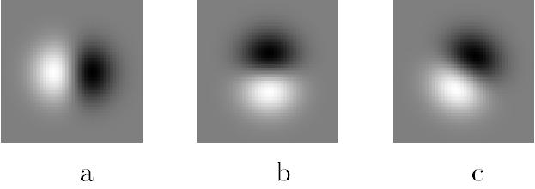
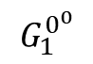
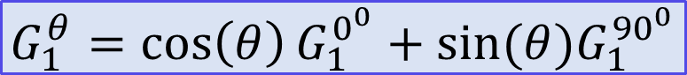
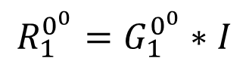
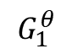
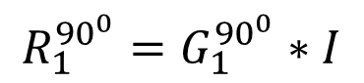
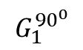
Freeman W T, Adelson E H. The design and use of steerable filters[J]. IEEE Transactions on Pattern Analysis & Machine Intelligence, 1991 (9): 891-906.
2.1 Steerable Filter
$$G_{1}^{θ}=\cos\left(θ\right)G_{1}^{0^{0}}+sin⁡(θ)G_{1}^{{90}^{0}}$$
Convolution is a linear operation
x=au, y=bv.
$$R_{1}^{0^{0}}=G_{1}^{0^{0}}∗I$$
$$R_{1}^{θ}=G_{1}^{θ}∗I={\cos\left(θ\right)R}_{1}^{0^{0}}+{\sin\left(θ\right)R}_{1}^{0^{0}}$$
$$R_{1}^{{90}^{0}}=G_{1}^{{90}^{0}}∗I$$
Y
(x,y)
v
$$G_{1}^{0^{0}}$$
$$G_{1}^{{90}^{0}}$$
$$G_{1}^{θ}$$
u
X

Slide 8
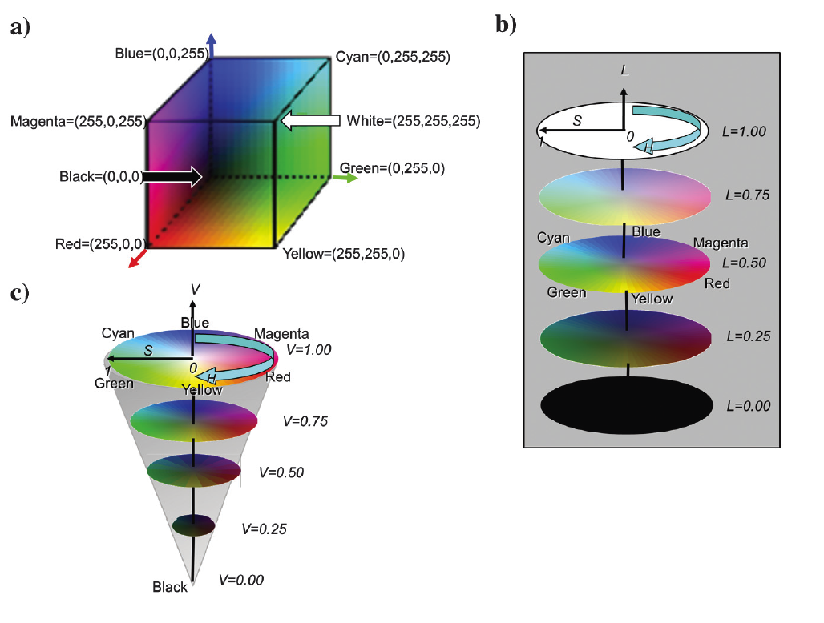
2.2 HLS color models
Marfurt K J. Techniques and best practices in multiattribute display[J]. Interpretation, 2015, 3(1): B1-B23.
HSV: hue-saturation-value
HLS: hue-lightness-saturation
Multi-attribute Display: Different attributes correspond to different color channels in HLS.
e.g. orientation corresponds to hue
edge corresponds to lightness
saturation is set to 1
(a)RGB (b)HLS (c)HSV

Slide 9
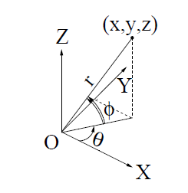
2.3 3D flow chart
(H)
(L)

Slide 10
Introduction
Method
Experiment
Conclusion

Slide 11
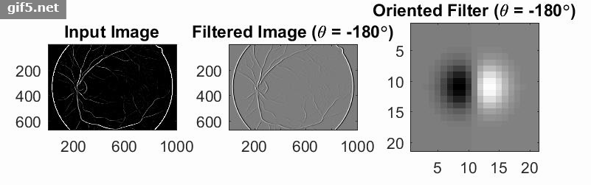
3.1 2D Steerable Filter

Slide 12
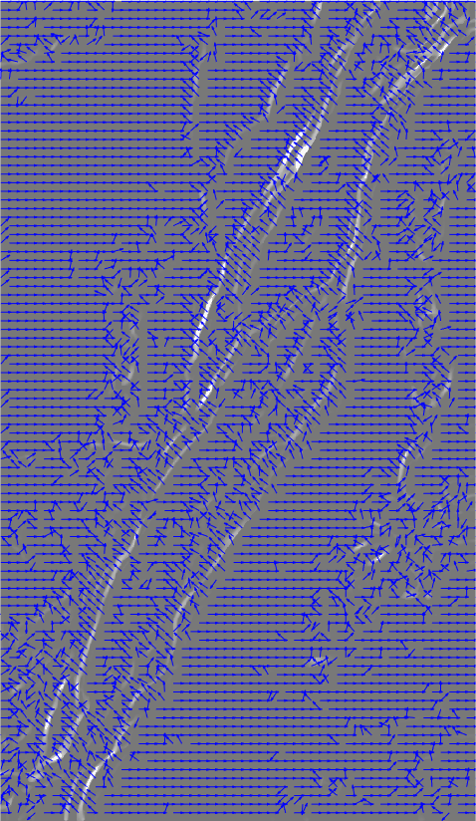
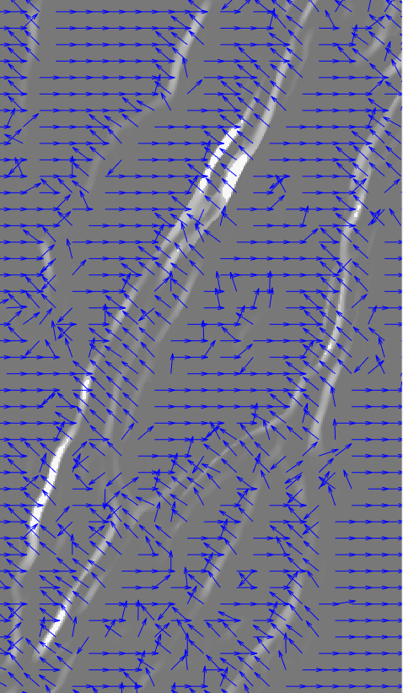
二维矢量化

Slide 13
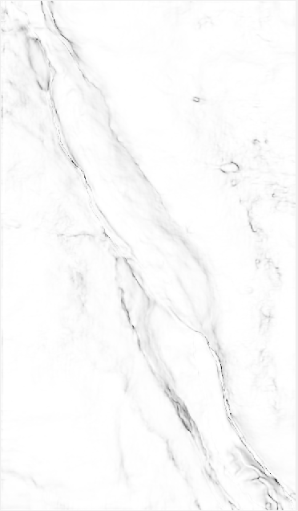
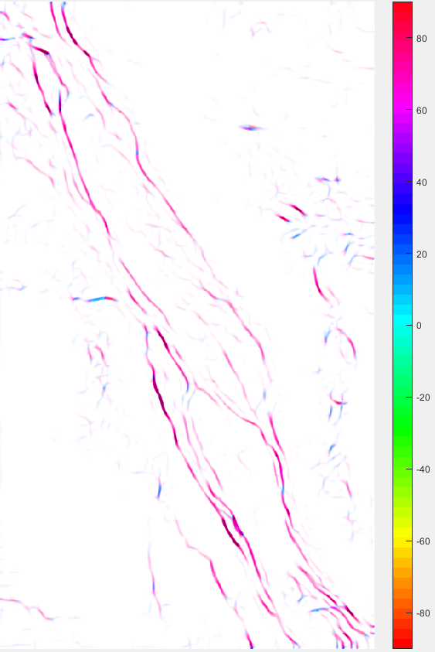
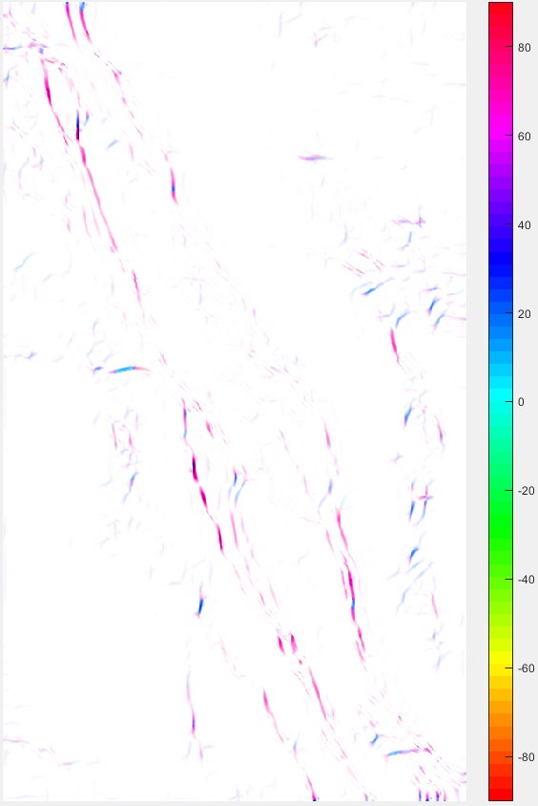
原图
不带方向约束
去除θ=-60°方向的裂缝

Slide 14
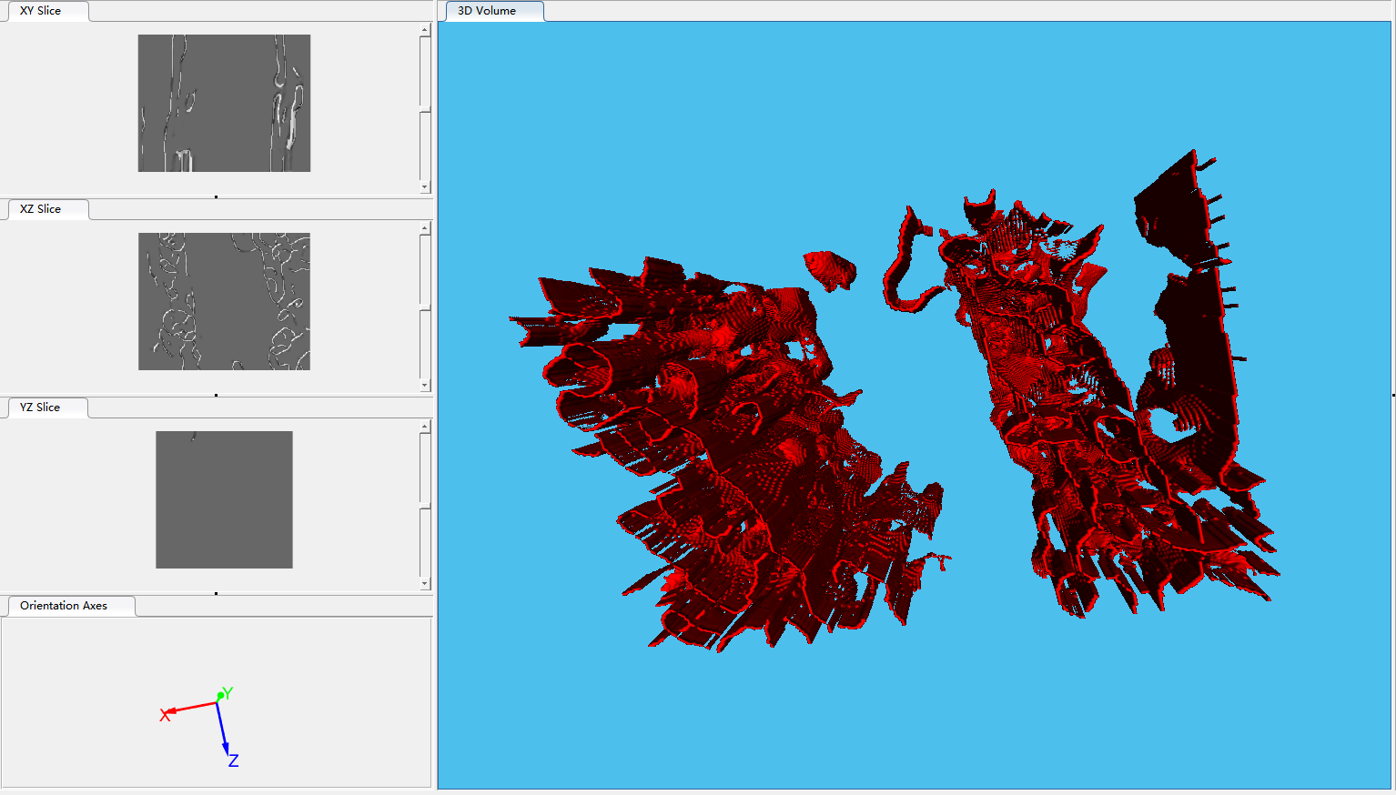
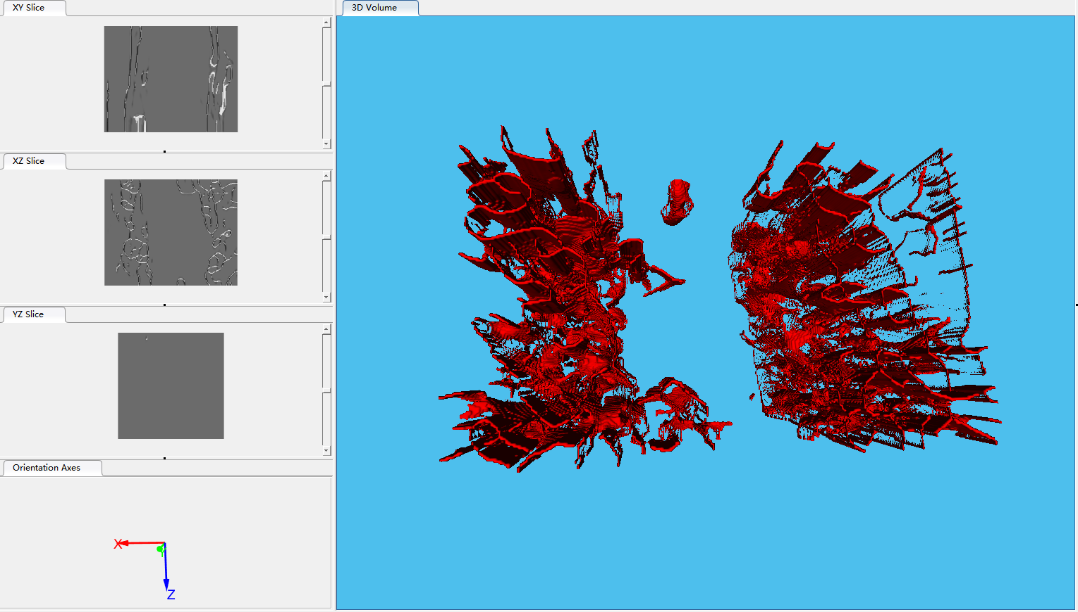
3.2 3D Steerable Filter
不带方向约束
去除θ=0°，φ=90°方向的裂缝

Slide 15
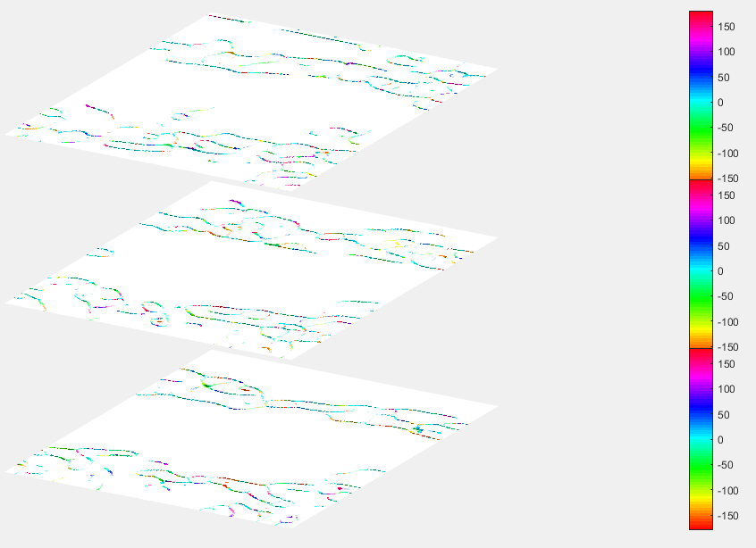
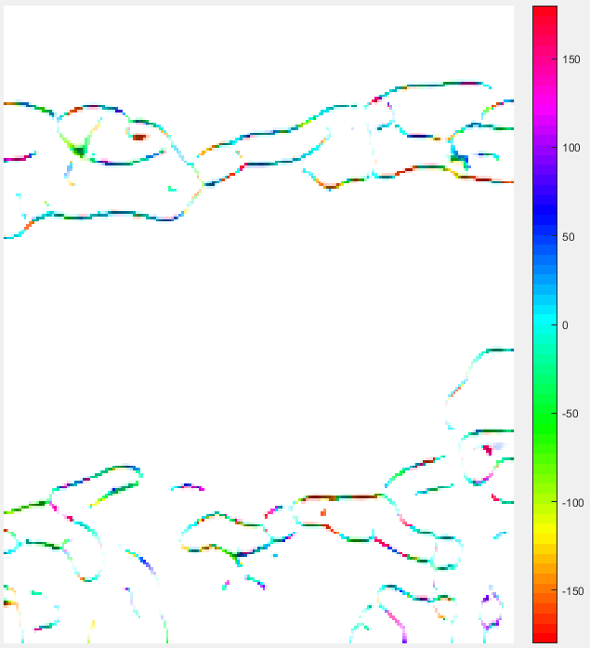
3.2 3D Steerable Filter
裂缝倾角θ显示

Slide 16
Introduction
Method
Implementation
Conclusion

Slide 17
4. conclusion
The main work :
Implemented 3D orientation filter
Completed 3D fault/crack model reconstruction
Completed multi-attribute fusion display
Next plan:
Code portability
Project acceptance
More achievements

Slide 18
Extra content

Slide 19
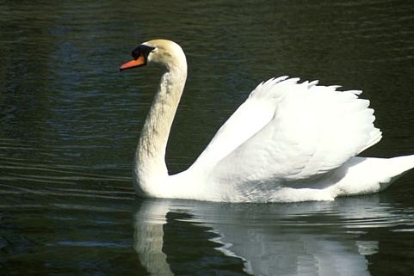
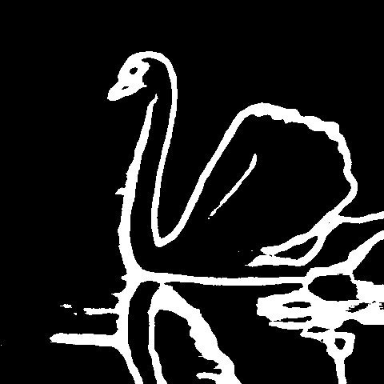
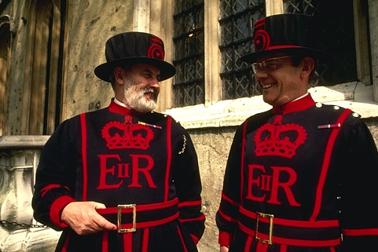
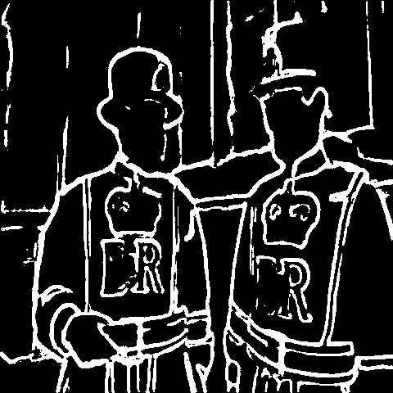
E1 HED

Slide 20

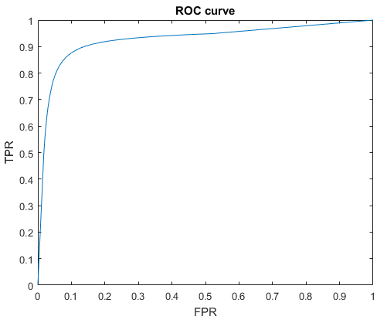
E2 ROC
https://github.com/LiaoLIDIP/NewROC

Slide 21
THANKS
https://github.com/LiaoLIDIP/Slide-IDIPLab

Slide 22
Appendix

Slide 23
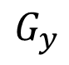
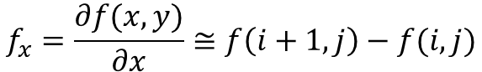
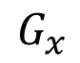
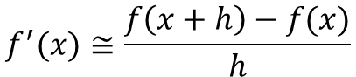
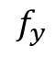
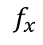
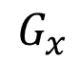
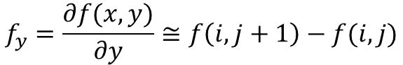
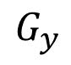
1.2 Classic Edge detection Algorithm
Roberts (1963)
$$f^{′}(x)≅\frac{f\left(x+h\right)−f(x)}{h}$$
[-1] | 0
0 | 1
0 | [-1]
1 | 0
$$f_{x}=\frac{∂f(x,y)}{∂x}≅f\left(i+1,j\right)−f(i,j)$$
-1 | 1
$$f_{x}$$
$$f_{y}=\frac{∂f(x,y)}{∂y}≅f\left(i,j+1\right)−f(i,j)$$
-1
1
$$f_{y}$$
Prewitt (1970)
Sobel (1970)
-1 | 0 | 1
-1 | 0 | 1
-1 | 0 | 1
-1 | [0] | 1
-1 | 0 | 1
-1 | -1 | -1
0 | [0] | 0
1 | 1 | 1
-1 | 0 | 1
-2 | [0] | 2
-1 | 0 | 1
-1 | -2 | -1
0 | [0] | 0
1 | 2 | 1
1
1
1
1
2
1
$$G_{x}$$
$$G_{y}$$
$$G_{x}$$
$$G_{y}$$

Slide 24
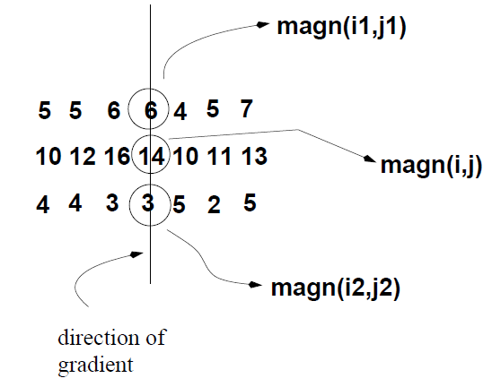
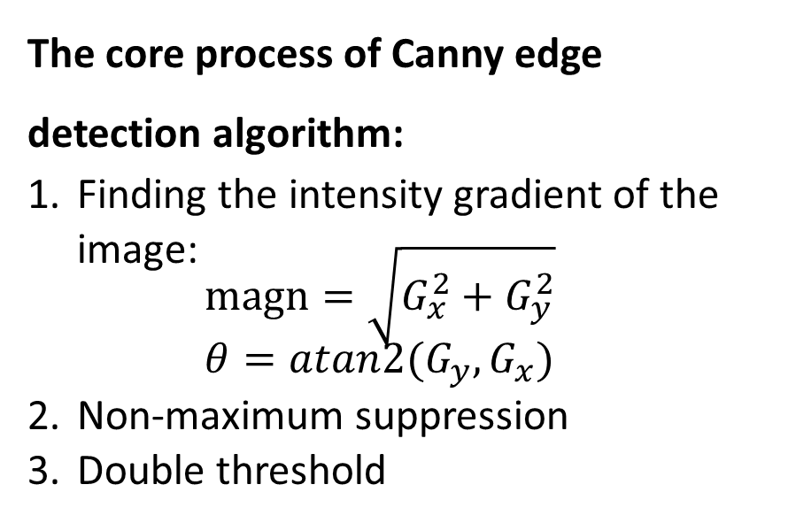
1.2 Classic Edge detection Algorithm
All value along the direction of the gradient that are not peak values of a ridge are suppressed.
Canny (1986)
The core process of Canny edge detection algorithm:
Finding the intensity gradient of the image: $magn=\sqrt{G_{x}^{2}+G_{y}^{2}}$ $θ=atan2(G_{y},G_{x})$
Non-maximum suppression
Double threshold
weak edge pixel
0
1
non-edge pixel
strong edge pixel

